Slide 1

Test Launch - Survey Results

Slide 2
Since the past quarter, we’ve been working on the Sauce & Spoon : Tablets Rollout project and recently we successfully managed to complete the test launch
It was a challenging task to reach this far but all the team really stepped up and worked together to make this launch successful
The challenges included; delayed shipment of tablets, team trainings and getting all the stakeholders on-board for this launch
Summary

Slide 3
We conducted a survey on test launch and got feedback from 50 customers
The team wanted to measure the following aspects:
Most Ordered Food Category
Customers experience with the tablets
Staff’s Role in onboarding customers
Tablets’ easy of use and navigation
Table wait time
Order wait time
Orders’ Accuracy
Customers’ confidence while payment through tablets
Suggestions / Complaints
Overview

Slide 4
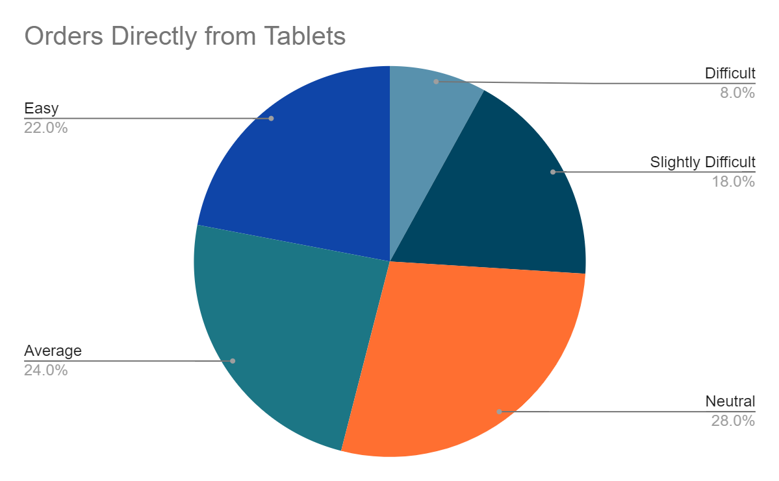
Findings

Slide 5
Enhance user experience more
Raise the customers’ rating for ‘Easy’ from 22% to 40%
Next Steps

Slide 6
Add fun activities in tablet
These activities will keep customers busy while waiting for their order
This will be really help for single customers and kids
Next Steps

